Slide 1
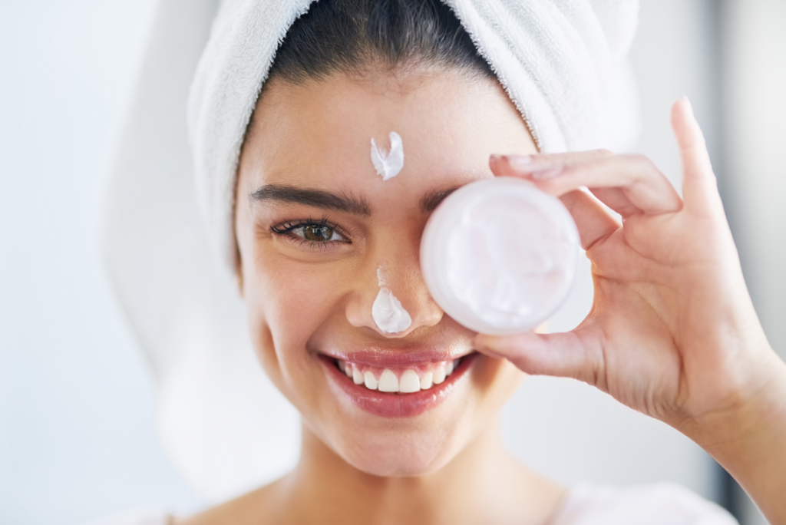
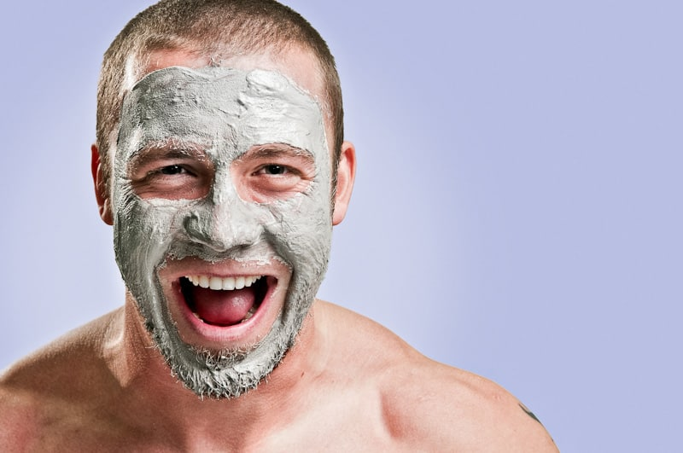
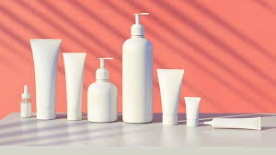
Skin Care Recommendation System
Victoria Loo
Institute of Data – Mini Project 3

Slide 2
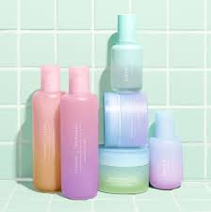
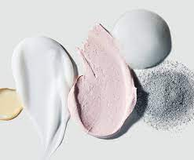
AGENDA
Business overview
Business Question
Project Pipeline
EDA
Models & Evaluation
Summary
Questions

Slide 3
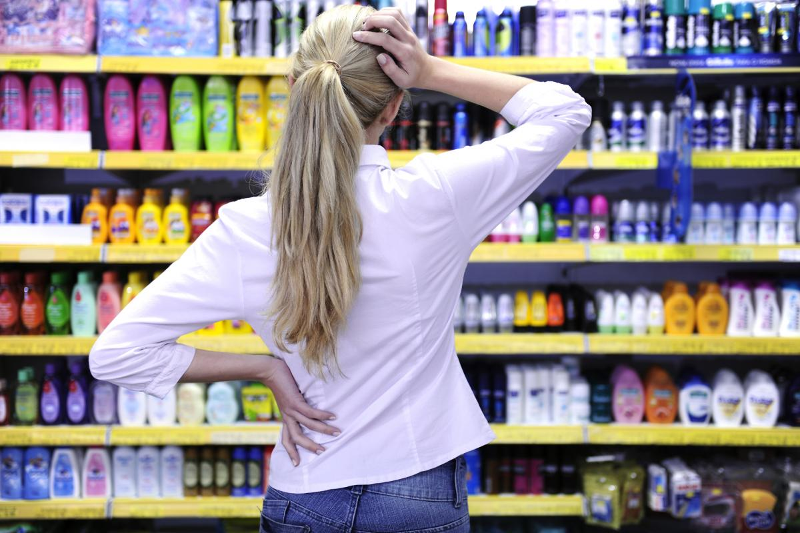
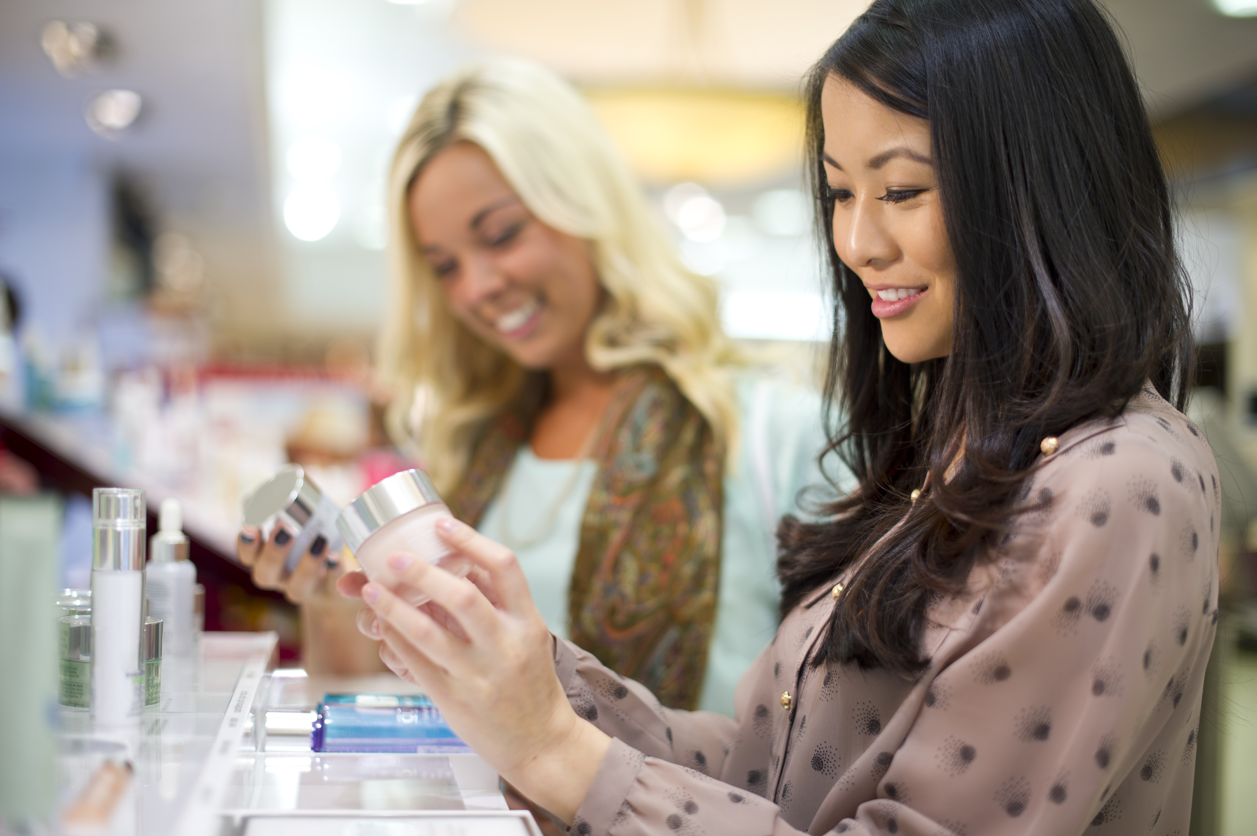
PURCHASING DILEMMA

Slide 4
RECOMMENDATION SYSTEM in Skin Care Industry
OVERVIEW
Traditionally, people tend to buy products recommended by friends/family.
A solution to offer customers with relevant product recommendations in real-time.
Use algorithms and data analysis techniques to recommend most relevant product items to a particular customer.
Stimulate demand and actively engage customers.
Netflix’s recommendation engine is worth a yearly $1 billion.
BENEFITS
Increase Sales and Revenue
Encourage website visitors to add tailored recommendation at the checkout page
Enhance Customer Experience
Provide personalised product suggestions that are most relevant to customers

Slide 5

Global Skin Care Revenue
in 2020
$145.3
billion
South Korea
$6.9 bil
Japan
$17.1 mil
United States
$17.6 bil
China
$14.2 bil
Australia
$1.4 bil

Slide 6
Business Question
How can we offer personalized recommendations to enhance customer experience and increase revenue?
Data Question
What model can we create and use to offer personalised recommendations to each customer?

Slide 7
PROJECT PIPELINE
Business
Question
EDA & preprocessing
Model
Deployment
Data
Acquisition
Model Building & Evaluation

Slide 8


DATA OVERVIEW
Data Source: Kaggle
Number of Products: 1472
Number of Features: 9
PRODUCT TYPE : MOISTURISER / CLEANSER / TREATMENT / SUN PROTECT / FACE MASK / EYE CREAM
BRAND
PRODUCT NAME
PRICE ($)
RANK
INGREDIENTS
SKIN TYPE : COMBINATION / DRY / NORMAL / OILY / SENSITIVE
NUMBER OF REVIEWS
NUMBER OF LOVES

Slide 9
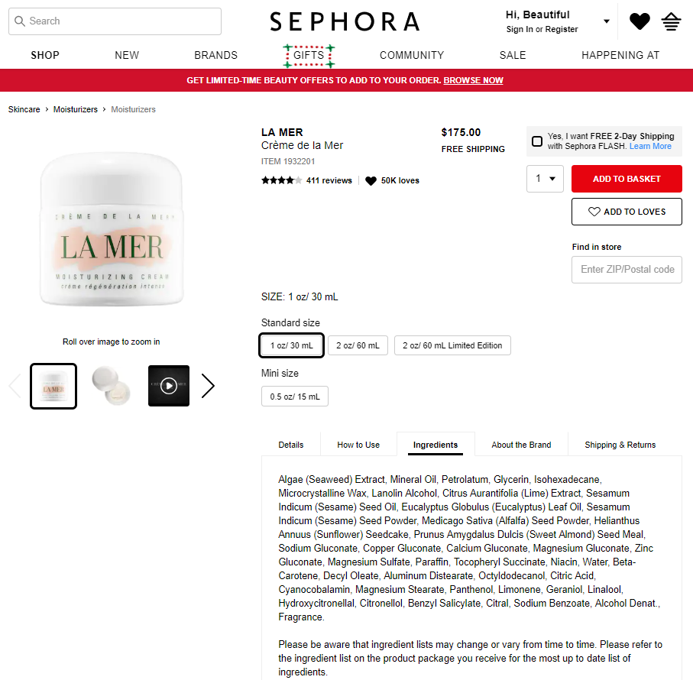
DATA OVERVIEW

Slide 10
DATA OVERVIEW
ALGENIST | FARMACY | MAKE UP FOR EVER | TATA HARPER
AMOREPACIFIC | FARSÁLI | MAKEUP ERASER | TATCHA
ANTHONY | FENTY BEAUTY BY RIHANNA | MDSOLARSCIENCES | TOM FORD
APIVITA | FIRST AID BEAUTY | MILK MAKEUP | TOO COOL FOR SCHOOL
BAREMINERALS | FOREO | MOON JUICE | TOO FACED
BEAUTYBIO | FRESH | MOROCCANOIL | URBAN DECAY
BECCA | GLAMGLOW | MURAD | VITA LIBERATA
BELIF | GLOW RECIPE | NARS | VOLITION BEAUTY
BIOEFFECT | GO-TO | NATURALLY SERIOUS | WANDER BEAUTY
BIOSSANCE | GUERLAIN | NEOGEN DERMALOGY | YOUTH TO THE PEOPLE
BLACK UP | HERBIVORE | NUFACE | YVES SAINT LAURENT
BLITHE | HUM NUTRITION | NURSE JAMIE
BOBBI BROWN | ILIA | OLEHENRIKSEN
BOSCIA | INDIE LEE | OMOROVICZA
CANE + AUSTIN | IT COSMETICS | ORIGINS
CAUDALIE | J.ONE | PEACE OUT
CHARLOTTE TILBURY | JACK BLACK | PERRICONE MD
CLARINS | JOSIE MARAN | PETER THOMAS ROTH
CLARISONIC | KAPLAN MD | PHILOSOPHY
CLINIQUE | KAT VON D | PRIVATE DOCTOR
COOLA | KATE SOMERVILLE | REN CLEAN SKINCARE
COVER FX | KENZOKI | SAND & SKY
DERMADOCTOR | KIEHL'S SINCE 1851 | SATURDAY SKIN
DERMAFLASH | KLORANE | SEPHORA COLLECTION
DIOR | KOH GEN DO | SHISEIDO
DR ROEBUCK’S | KOPARI | SK-II
DR. BRANDT SKINCARE | KORA ORGANICS | SKIN INC SUPPLEMENT BAR
DR. DENNIS GROSS SKINCARE | KORRES | SKIN LAUNDRY
DR. JART+ | LA MER | SMASHBOX
DRUNK ELEPHANT | LANCER | SON & PARK
EDIBLE BEAUTY | LANCÔME | ST. TROPEZ TANNING ESSENTIALS
ERBORIAN | LANEIGE | SUMMER FRIDAYS
ERNO LASZLO | LAURA MERCIER | SUNDAY RILEY
ESTÉE LAUDER | LIGHTSTIM | SUPERGOOP!
EVE LOM | L'OCCITANE | TARTE
116
Skin Care Brands

Slide 11
EXPLORATORY DATA ANALYSIS
Products are equally distributed into 6 skin care categories.
Moisturizer received
highest number of loves
by customers.

Slide 12
EXPLORATORY DATA ANALYSIS
On average, price ranges
between $33-$79.
Average rating for most
product types is 4 and above.

Slide 13
TYPES OF RECOMMENDATION MODELS
Recommendation Engine
Personalised Recommendation
Machine Learning Algorithm
Deep Learning Algorithm
Non-Personalised Recommendation
Content-Based Filtering
Collaborative Filtering
Matrix Factorisation

Slide 14
NON-PERSONALISED RECOMMENDATIONS

Slide 15
Top 10 Most Loved Brands
(total 116 skin care brands)
Top 7 Cheapest Sunscreen
PRODUCT | BRAND | PRICE ($)
Mineral Sunscreen Stick Broad Spectrum SPF 40 UVA-UVB Sunscreen | MDSOLARSCIENCES | 18
Everyday Sunscreen Broad Spectrum SPF 50 | SUPERGOOP! | 19
Pep-Start Daily UV Protector Broad Spectrum SPF 50 | CLINIQUE | 19
Quick Dry Body Spray With SolSci-X™ Broad Spectrum SPF 40 UVA-UVB Sunscreen | MDSOLARSCIENCES | 20
Oil-Free Sun Guard Sunscreen Water Resistant SPF 45 | JACK BLACK | 21
Ultimate Sun Protection Lotion WetForce SPF 50+ Mini | SHISEIDO | 22
8 HR Mattifying Moisturizer Sunscreen Broad Spectrum SPF20 | SEPHORA | 23
1. CLINIQUE
2. TATCHA
3. FRESH
4. SEPHORA COLLECTION
5. KIEHL'S SINCE 1851
6. LANEIGE
7. CAUDALIE
8. BOSCIA
9. SUNDAY RILEY
10. FIRST AID BEAUTY
NON-PERSONALISED
RECOMMENDATIONS
Use Exploratory Data Analysis
Do not take account of
customer’s unique preferences
Recommendations are identical
for each customer
Top 10 Most Reviewed Products
(total 1472 products)
Top 10 Most Loved Moisturiser

Slide 16
PERSONALISED RECOMMENDATIONS

Slide 17
Content-Based Recommendation (Machine Learning Algorithm)
Ingredient Based Filtering
Use Ingredients as main features.
Natural Language Processing
Tokenising the ingredients.
t-SNE Reduction Technique
2,233 features
Create cosmetic – ingredient matrix (via encoding).
Downsize into 2 dimension for visual.

Slide 18
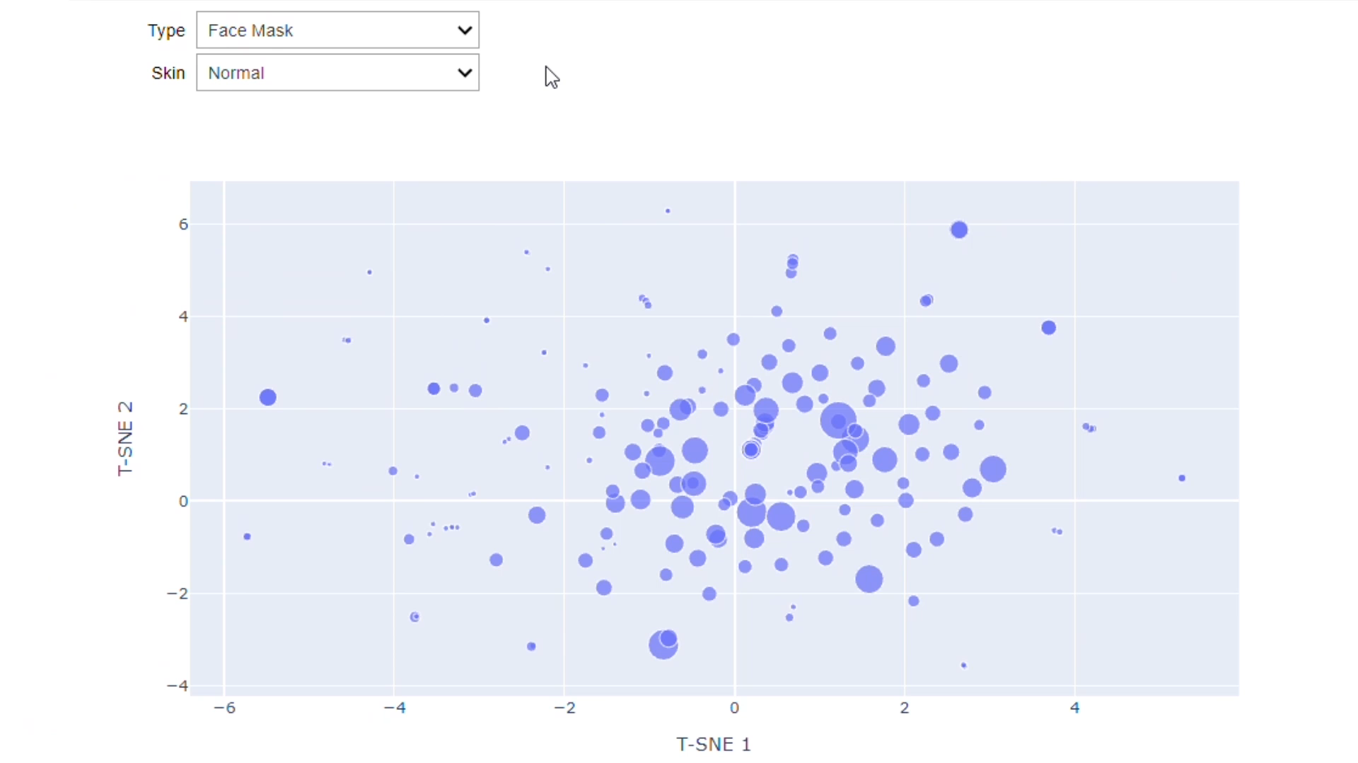
Ingredient-Based Recommendation
Drop Down Menu
Product Type
(Moisturiser, Cleanser,
Face Mask, Eye Cream,
Treatment, Sun Protect)
2. Skin Type
(Combination, Oily,
Normal, Dry)

Slide 19
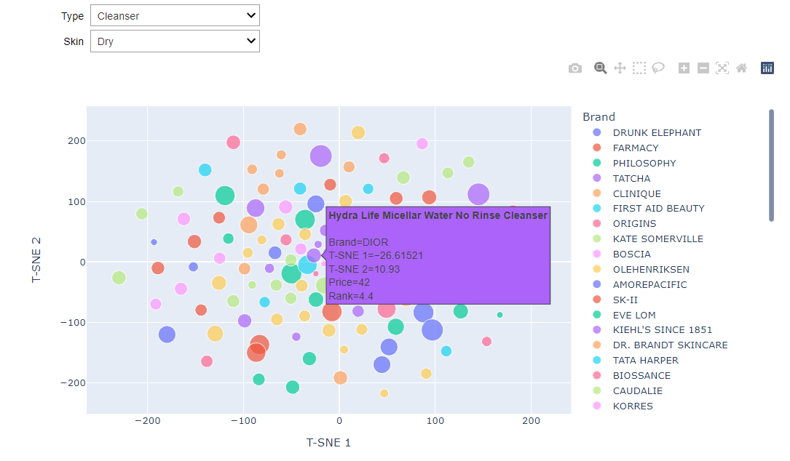
Ingredient-Based Recommendation

Slide 20
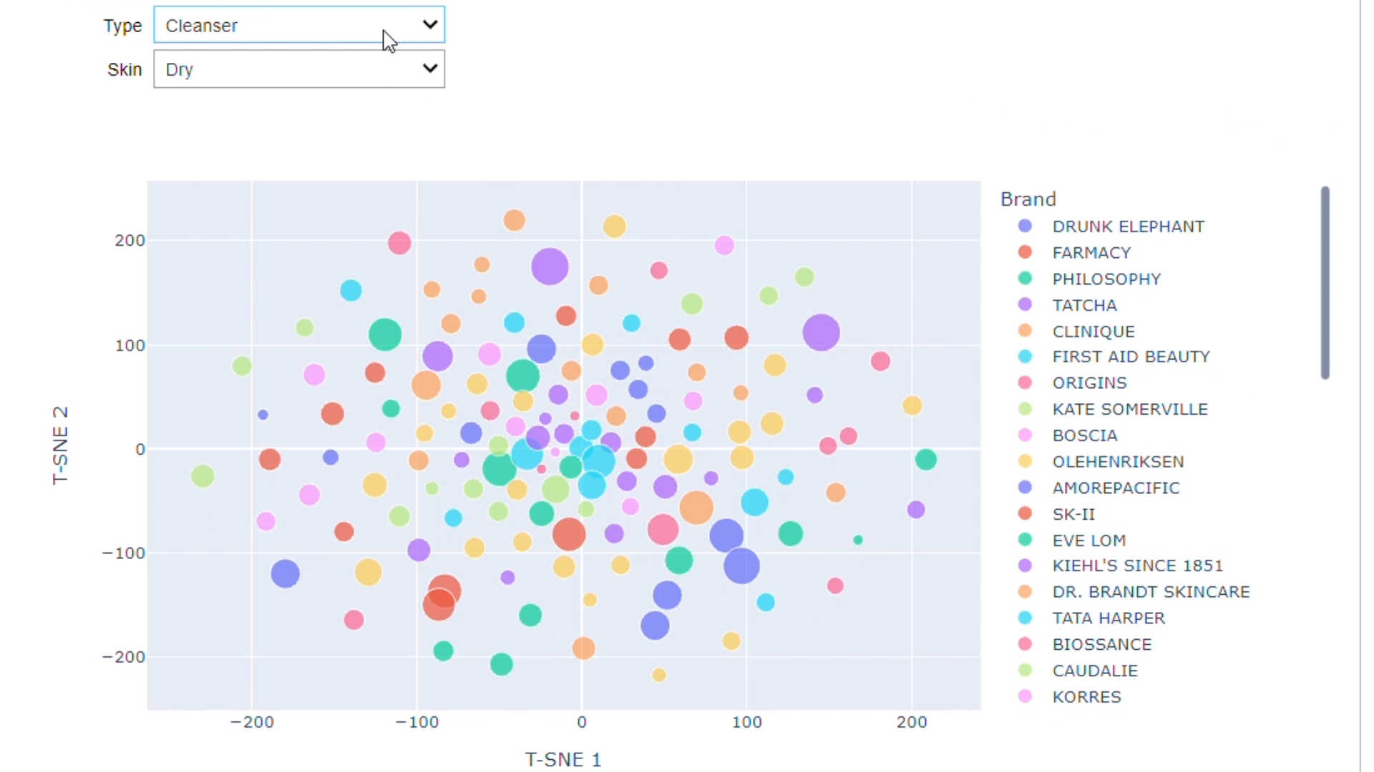
Ingredient-Based Recommendation

Slide 21
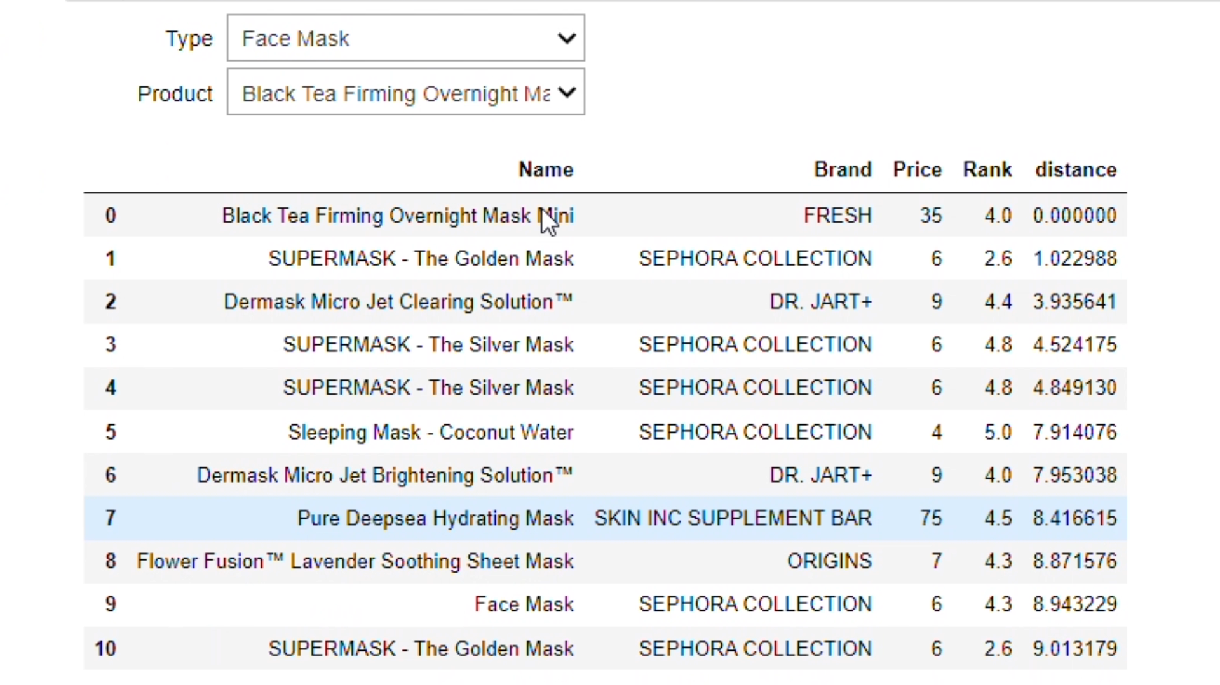
Ingredient-Based Recommendation

Slide 22
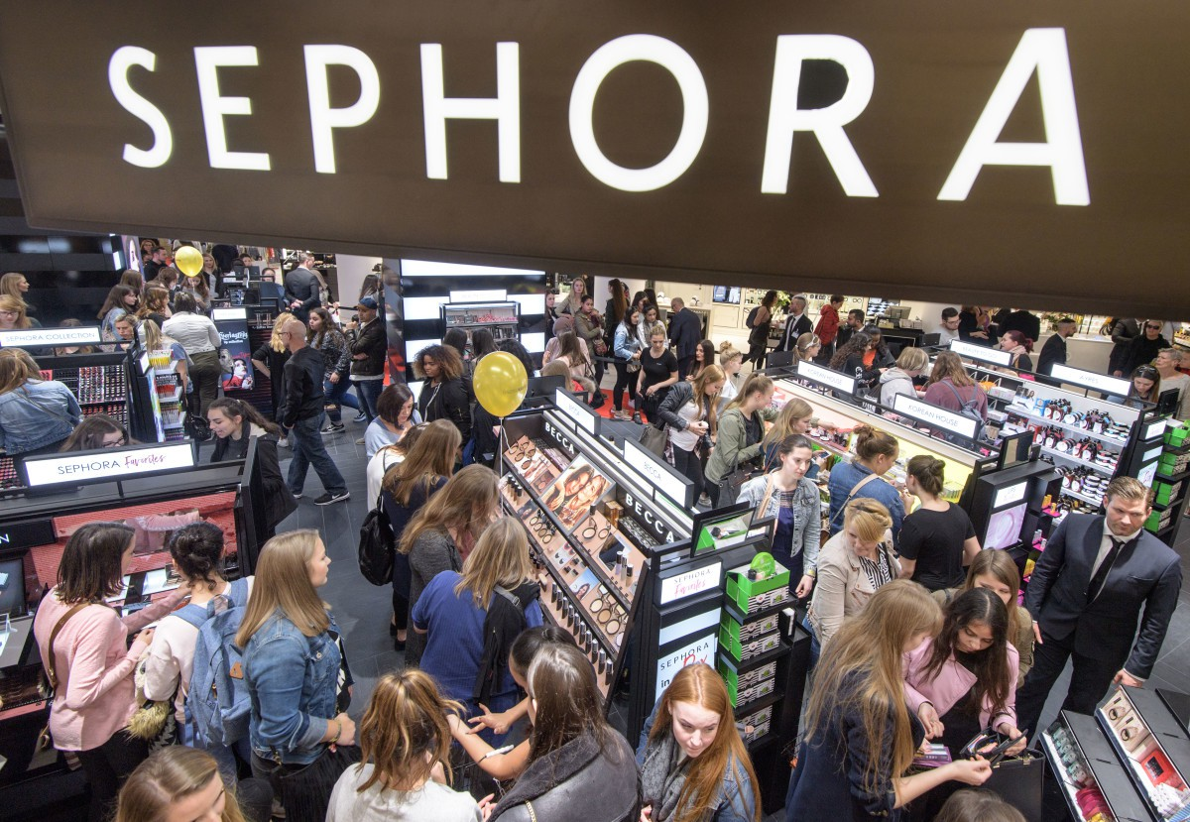
SUMMA RY
Non-Personalised Recommendation model provides general recommendations to the customer without any context of what customer wants or what is their preference, by using data analysis.
Personalised Recommendation model provides tailored recommendations to each customer, by using machine learning algorithm.
Ingredient-Based Recommendation model will allow customers to identify products with similar ingredients, without any knowledge of the chemical ingredients in the skin care products.

Slide 23
NEXT STEPS
Deploy model to gain real customer feedbacks
Increase number of products to expand scope of current recommendation model
Extract user data to create a more intuitive and comprehensive recommendation model
Apply deep learning algorithm

Slide 24
Thank You!

